Slide 1
BINARY ENCODING OF TURING MACHINE
18CSC301T – Formal Language and Automata
BY
RA2111026010127 Cheedella S V Abhinava Sai
RA2111026010117 Thangala Nithin Kumar
RA2111026010135 Harsha Shiva Shankar

Slide 2
Objective Application
The objective of using binary encoding in a Turing machine is primarily to represent and manipulate information or data in a more compact and standardized form.
Binary encoding in Turing machines has various applications across different fields and problem-solving domains:
Data Processing and Computation
Algorithm Development and Analysis
Data Compression and Transmission
Computer Graphics and Image Processing
Cryptography

Slide 3
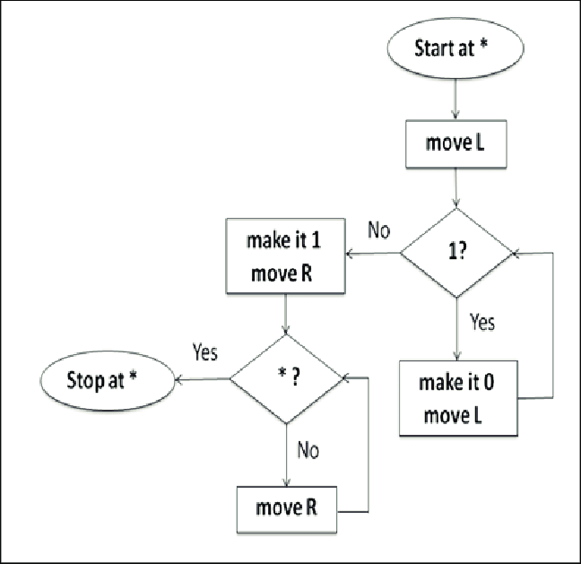
Flow Chart
Diagrammatic representation of Binary Encoding of a Turing Machine

Slide 4
Procedure
Encode the symbols that the Turing machine uses on its tape. For instance, if the machine has 'm' symbols, assign a unique binary code to each symbol
Encode the transition rules for the Turing machine. These rules define what action the machine should take when in a particular state, reading a specific symbol. Each rule consists of: Current state, Symbol read, Action
Represent the current state using its binary code
Encode the symbol being read on the tape using its binary representation
Define the action to take when in a certain state and reading a specific symbol
Concatenate these binary representations for the current state, symbol read, action (write, move, next state) to form a single binary string that represents the transition rule
This completes the binary encoding of a Turing machine

Slide 5
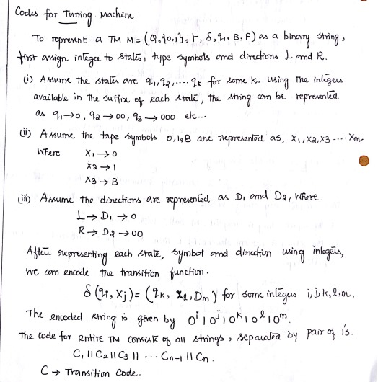
Example Problem
Simple example of binary encoding of a Turing machine

Slide 6
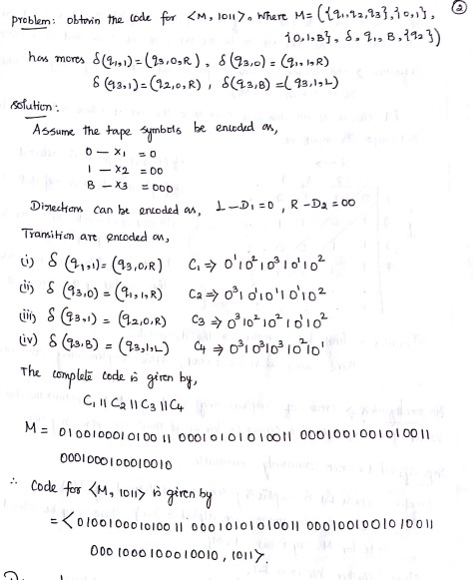

Slide 7
Implementation

Slide 8
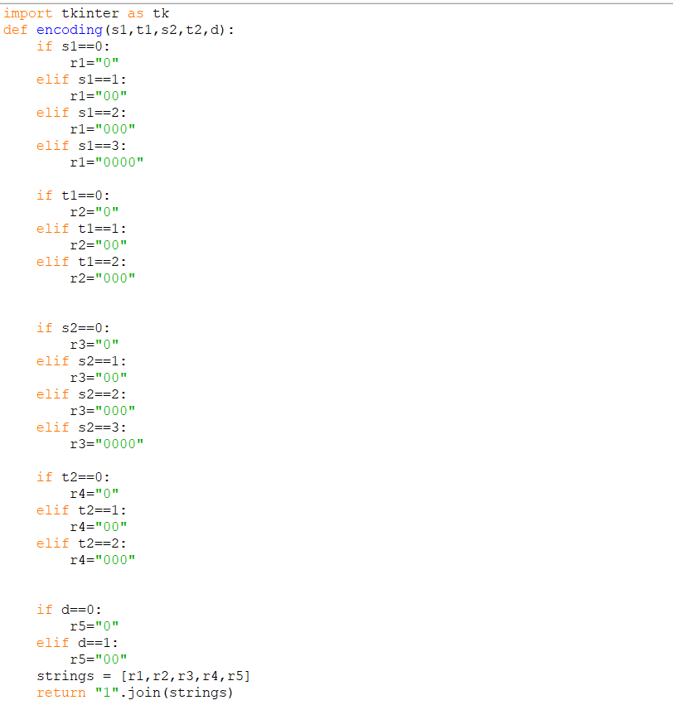
Implementation

Slide 9
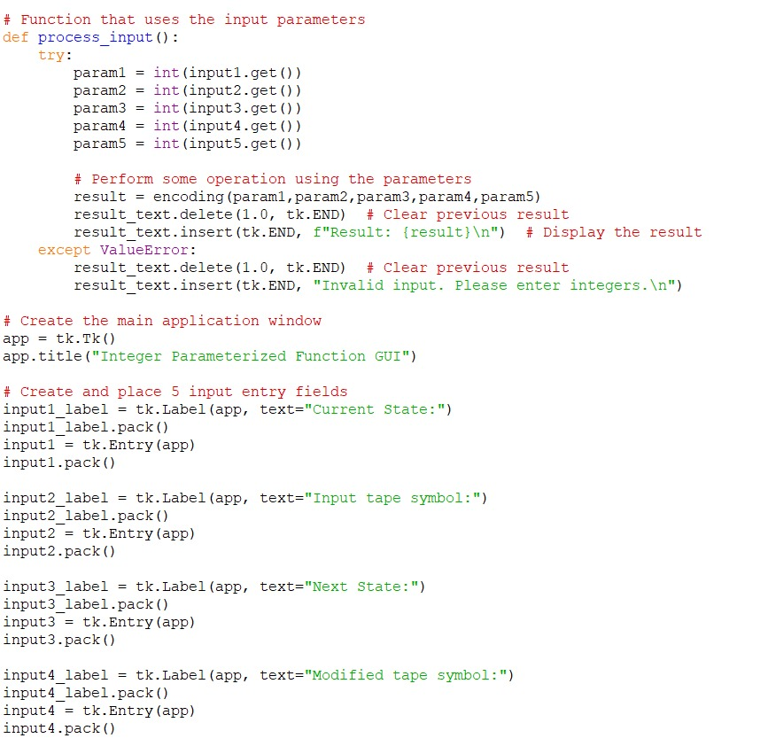

Slide 10
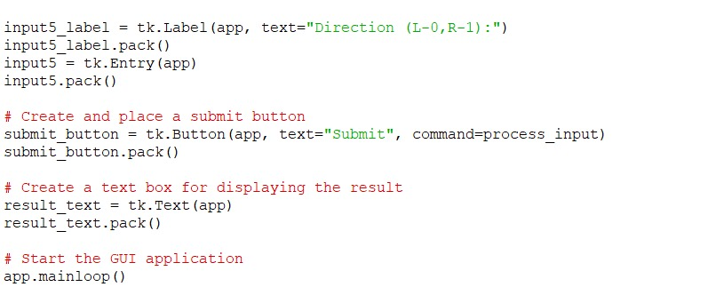

Slide 11
Results

Slide 12
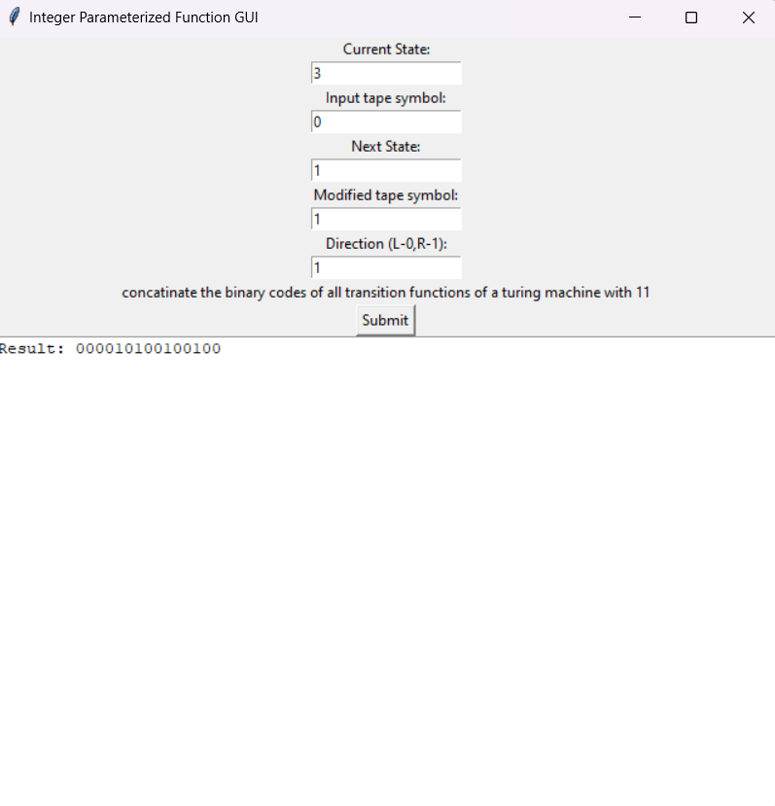
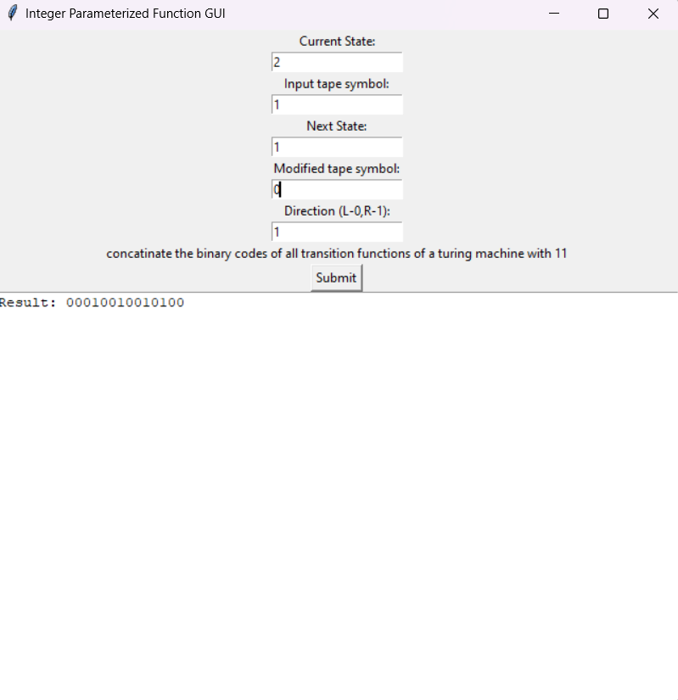

Slide 13
Conclusion
In this project, we successfully implemented a binary encoding of a Turing machine transition function and provided a user-friendly GUI for users to interact with the encoded transition function. This project aimed to make the encoding and manipulation of Turing machine transition functions more accessible and intuitive, and we believe that it has achieved these goals.

Slide 14
Contribution
PPT – Harsha Shiva Shankar
Python Code for Binary Encoding – Cheedella S V Abhinava Sai
GUI Integration – Thangala Nithin Kumar Reddy
Github lilnk - Abhiat2004/Fla (github.com)

